Slide 1
Building a growth model for Rec

Slide 2
Quote
"Until they understand their Growth Model, many teams are overly focused on big, difficult to move output metrics, instead of its key inputs. - Dan Hockenmaier

Slide 3
Three lanes to acquiring customers - picking the right lane
Performance marketing
Virality
Content
Notes:
Performance marketing or virality for Rec
Virality - has worked the best
Performance marketing - ad words and FB etc
Content -

Slide 4
Thinking about your business like a high-performance race car
⚙️ The (Growth) Engine Self-sustaining growth loops that drive most of your growth (e.g. virality, performance marketing, content, and sales).
💥 Turbo boosts One-off events that accelerate growth temporarily but don’t last (e.g. PR, events, Super Bowl ads).
💧 Lubricants Optimizations that make the growth engine run more efficiently (e.g. improved customer conversion, a stronger brand, and higher customer retention).
⛽ Fuel The input that your engine requires to run (e.g. capital, content, users).
Notes:
Rec’s growth engine is virality
Turbo boosts - Big hot ticket fitness events - boxing events, preview, etc. - good for user acquisition, but not great for retention
Lubricants - Easy checkout, promotions, variety of classes
Fuel -

Slide 5
Different types of growth engines
Your growth engine will drive the majority of your growth, and so it’s critical that you get this right. As we’ve shared previously, companies grow primarily through four possible Growth Engines:
Performance marketing: FB, AdWords, TV, etc.
Virality: Word-of-mouth, referrals, inviting friends, etc.
Content: SEO, shareable videos, or newsletters, etc.
Sales: Outbound (and inbound) salespeople

Slide 6
Different types of growth engines
Your growth engine will drive the majority of your growth, and so it’s critical that you get this right. As we’ve shared previously, companies grow primarily through four possible Growth Engines:
Performance marketing: FB, AdWords, TV, etc.
Virality: Word-of-mouth, referrals, inviting friends, etc.
Content: SEO, shareable videos, or newsletters, etc.
Sales: Outbound (and inbound) salespeople

Slide 7
Examples of successful companies and their growth engines
Uber/Lyft: Virality + Performance marketing
Snapchat: Virality
Zoom: Virality + Sales
Slack: Virality + Sales
Salesforce: Sales
Thumbtack: Content + Performance marketing
Atlassian: Virality + Sales
Airbnb: Virality + Performance marketing
Eventbrite: Virality + Content
Tesla: Virality + Sales

Slide 8
3 step process to determine which engine is likely going to drive your growth and operationalize it: Validate, Commit, and Scale.
"1. Validate
The first step is to validate (as cheaply as possible) that a given lane is right for your business. There are two approaches to validating this. One, determining which lane is a natural fit for your business model. Two, looking at your data.
2. Commit
In our experience, most companies underestimate how large and disciplined the effort will need to be to turn any of these lanes into a superhighway.
Committing to a lane generally includes doing two things, both of which can be scary, particularly early in a company’s life:
Dedicating a significant amount of cross-functional resources to the effort, including product, design, marketing, and engineering
Influencing the core product roadmap and customer experience to optimize for the lane being pursued
3. Scale
Once you have committed to a lane and start to see meaningful results, the next phase is to become world-class at the lane. The hallmark of this third stage is overcoming diminishing returns. Virtually every customer acquisition channel becomes harder over time because you are acquiring lower and lower intent customers."

Slide 9
Turbo boosts
Example: PR, Events, Brand marketing campaigns
Are not sustainable or repeatable at scale
Valuable for kickstarting and accelerating your growth rate
Important for companies when lighting initial spark or launching new product or market

Slide 10
Lubricants
Don’t drive growth directly, ut instead optimize the efficiency of your engine
Conversion: increasing the rate of customers sign up.
Optimizing clickthrough rate on ads, effectiveness on of sales ppl, and increasing signup funnel conversion rates.
Activation: Increasing the rate at which customers use your product for its core purpose. This includes everything related to the new user experience and how your customers learn about and begin to use your product.
Retention: Improving the rate at which customers continue to use your product. This includes everything related to the ongoing customer experience.

Slide 11
Of these three categories, retention is the most important. As Brian lays out in this post:
"Retention is the core of your growth model and influences every other input to your model. This is important because if you improve retention, you’ll also improve the rest of your funnel." - Brian Balfour

Slide 12
Fuel
The type of fuel required is specific to the type of growth engine you’re running:
Paid marketing and sales engines primarily need capital, which can be invested in ads or salespeople. This is why payback is an important metric to measure marketing and sales engines: it determines how long it takes for enough cash to be generated to start the loop again.
Content engines unsurprisingly need more content, which can be used to attract users. Often, this content is generated by users, in the form of things like reviews, photos, or videos. In other cases, this content is generated by the company itself.
Viral engines require only more users, who in turn refer additional users. A common metric to measure virality is k-factor, or the number of new users each user refers. When this number is >1, the product will grow virally.

Slide 13
Step 2: Avoiding common pitfalls

Slide 14
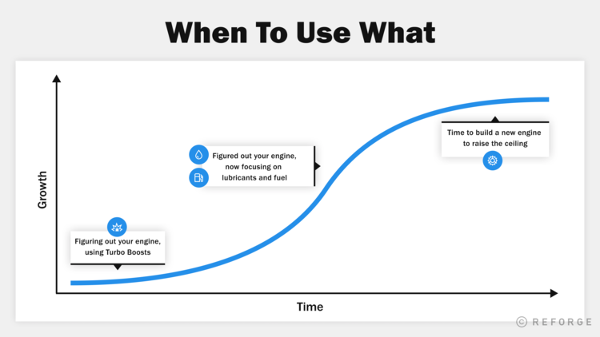

Slide 15
1. Focusing on ⚙️ Growth Engines when you actually need 💥 Turbo Boosts
Before you have users or capital, you need to find unscalable ways to “spark” the engine. This is done by focusing initially on Turbo Boosts (e.g. PR, events, direct reach-out) to get things started, and over time transitioning efforts to your primary engine(s).
This pitfall is most common in early stage startups, before an engine can drive your growth. All of the engines are a function of either the base amount of users you have or the capital you have. Early on, you don’t have either, so investing in Turbo Boosts makes sense.

Slide 16
2. MISTAKING A 💥 TURBO BOOST FOR A ⚙️ GROWTH ENGINE
Turbo boosts are good because it gets the word out to a lot of people. They are exciting and at that moment, you have people’s attention. But days later their attention is gone and so is their desire to use what you were selling.
At this point, it’s smarter to invest in your engine. Is the product (engine) good enough to retain the speed and continue to run? The turbo boost will temporarily accelerate, but then virality needs to take over.
"This is one of the most common mistakes among new product teams when I ask "How does your product grow?" The answer is typically a long list of turbo boosts. It is typically because there is no hypothesis on what the growth engine is, and as a result they are compensating by trying to cobble together a lot of little things." - Brian Balfour (Founder/CEO at Reforge, Ex-VP Growth at HubSpot)

Slide 17
3. FOCUSING TOO MUCH ON 💧 LUBRICANTS, WHEN YOU REALLY NEED A ⚙️ GROWTH ENGINE OR A 💥 TURBO BOOST
Conversion optimizing your way to growth is a common failure mode. In practice, the ROI on these initiatives will always remain low because you’re optimizing on a small flow of users vs. all of the potential new users out in the world. You’re often better off focusing on Turbo Boosts to drive more users than optimizing what you already have.

Slide 18
4. FOCUSING ON A NEW ⚙️ GROWTH ENGINE WHEN YOU NEED 💧 LUBRICANTS
This failure mode happens when teams fail to realize the true potential of their current Growth Engine, and instead start to focus on a new Growth Engine prematurely. Focusing on a new Engine too early, and not realizing that building a new engine is really hard, leads to sacrificing a lot of remaining upside with their existing Engine. Instead, teams should strive to tune the current Engine to its full potential. A lot of this is done by going through The Adjacent User.

Slide 19
5. NOT UNDERSTANDING WHAT TYPE OF ⛽ FUEL YOUR BUSINESS NEEDS
But if you’re growing primarily virally, you need less monetization to grow and want to reduce the friction of users trying and recommending your product as much as possible.

Slide 20
Step 3: Put this into practice

Slide 21
1. PRIORITIZING YOUR ROADMAP
When weighing the myriad of ideas your team has come up with for the year ahead, how do you decide which to prioritize and which to cut? Look to your ⚙️Growth Engines and understand what can make it run faster. Why? Because over the long term, you’ll need to be world-class at at least one engine in order to have a chance to stay in the race.

Slide 22
2. ORGANIZING TEAMS
Again, look to your ⚙️ Growth Engines when considering your org structure. What are the most important inputs to your engine, and who’s going to be responsible for each part?
For example, say your primary engine was Virality (specifically, users inviting friends). You likely want a person/team responsible for the three core steps of this loop:
New user acquisition
Conversion through the funnel
Friend invite rate

